Slide 1
Online One Week Short Term Training Programme on Python Programming.
Prepared By,
A.Thomas Mary Sheeba,AP/IT

Slide 2
Day 1 - Agenda
Overview
Features
Companies using Python
Why Python is popular?
Installation Procedure
Modes of Python

Slide 3
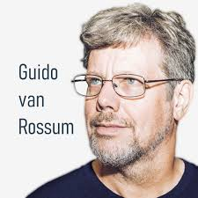
OVERVIEW
Guido Van Rossum during 1985 – 1990
First version (0.9.0) published in February 1991
Derived from ABC programming language
Name Python comes from Monty Python’s Flying Circus.

Slide 4
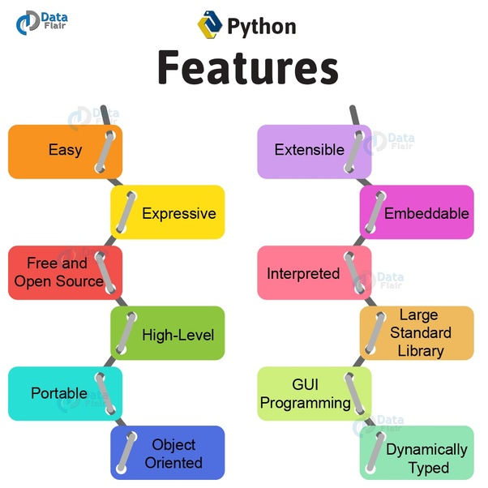

Slide 5
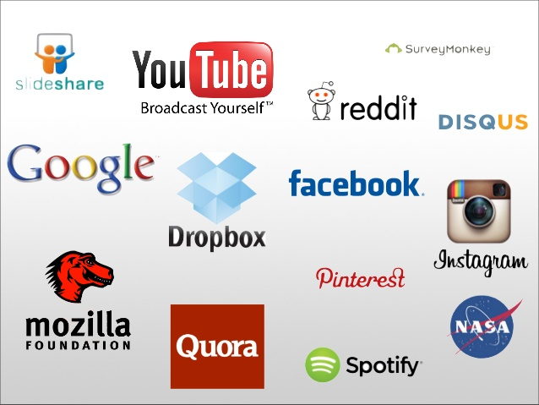
Companies using Python

Slide 6
Why Python is Popular?
Software Engineers
Mathematicians
Data Analysts
Scientists
Accountants
Network Engineers

Slide 7
Areas
Data Analysis and Visualization
Artificial Intelligence
Machine Learning
Automation

Slide 8
Uses of Python
Web Application
Mobile Application
Desktop Application
Software Testing
Hacking

Slide 9
Reasons
Less time and few lines of code
Eg : To write a program to print “Hello World”
High level Language
Cross Platform
Huge Community
Large Ecosystem
Java | C | Python
public class HelloWorld { public static void main (String[] args) { System.out.println("\n Hello World "); } } | #include <stdio.h> int main() { printf("\n Hello World"); return 0; } | Print(“Hello World”)

Slide 10
Python is
A Multi Purpose Language
Simple
Beginner Friendly Syntax

Slide 11
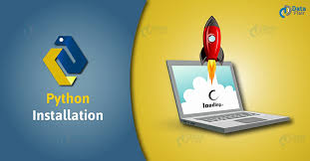

Slide 12
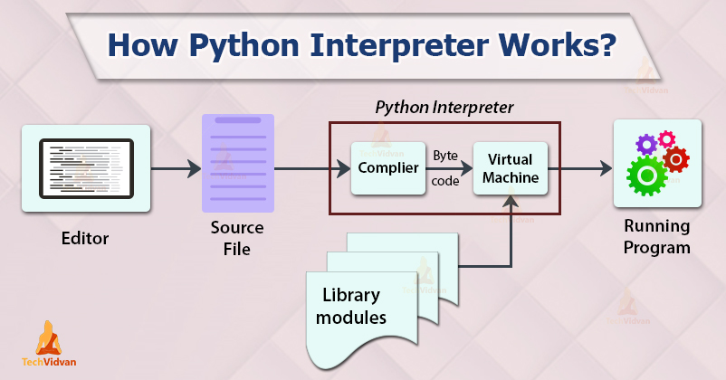

Slide 13
Modes of Python
Interactive Mode
Script Mode

Slide 14


